Slide 1
晶体学
Crystallography

Slide 2
Crystallography (MSE203)
Time and location:
Tuesday, 2:00-3:50 PM; Teaching Building I, 305 (Class I, Bilingual)
Thursday, 2:00-3:50 PM ; Teaching Building I, 304 (Class II, English)
Instructor:
Dr. Chun CHENG
Email: chengc@sustech.edu.cn；
Room 204, North Building, Institute of Technology
Teaching assistants:
Mrs. Yulan Huang（黄毓岚）
Email: 11953006@mail.sustech.edu.cn；QQ group1： 1002509385
Mr. Yichen Gan（甘翊辰）
Email: 12132034@mail.sustech.edu.cn；QQ group2： 644161794
Notes:
Upperclassman 学长
Class I is bilingual and class II is taught in English.

Slide 3
introduction
MSE department
Dr. Cheng and his research

Slide 4
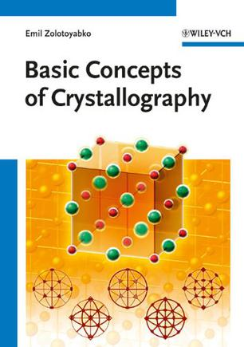
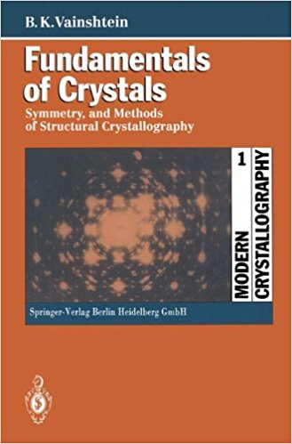
Crystallography (MSE203)
Reference books （Chinese）:
晶体学讲义
晶体学基础, 2004年9月第1版, 秦善, 北京大学出版社, ISBN 9787301075180;
现代晶体化学, 2001年8月第一版, 陈敬中, 高等教育出版社, ISBN 7040099241
现代晶体学（第1卷）晶体学基础；现代晶体学（第2卷）晶体的结构，2011年7月第一版; B·K伐因斯坦(Vainshtein B.K.), 中国科学技术大学出版社, ISBN 9787312027826 (此书有中、英及俄文版本)
Undergraduate
Postgraduate
Reference books （English）:
Lectures
Basic concepts of crystallography, 20110101，Emil & Zolotoyabko, Weinheim, Germany;
Fundamentals of crystals symmetry and methods of structural crystallography , 1994, B.K. Vainshtein, Springer;
Defects in Crystals, http://www.tf.uni-kiel.de/matwis/amat/def_en/index.html
Professional

Slide 5
Crystallography (MSE203)
Syllabus
Introduction to crystal
Crystal formation
Crystal projection
Space lattice & crystallographic symbol
Macroscopic symmetry of crystal
Microscopic symmetry and space groups of crystal
Ideal crystal morphology
Defects in crystals
Crystal chemistry
Crystal physics
Crystal characterization technologies: x-ray diffraction
Crystal characterization technologies: transmission electron microscopy
Notes:
In order to analyze the crystal structure, we need to project the crystal, to simplify the three-dimensional problem into a two-dimensional one; At the same time, we have some specific terms for describing the structure of crystals. Next, we study crystal from macroscopic and microscopic symmetry aspects. Finally we discuss the ideal form of crystals deduced by the space groups. All the above are ideal crystals, and all the crystals that exist in nature are imperfect, so let's take a closer look at the defects in crystals. For 9 through 12

Slide 6
Crystallography (MSE203)
Syllabus
SCORES (100+5 bonus)
Attendance* and Class performance 10%
Quiz 5%
Project 5%
Assignment 10%
Mid-term projects 30%
Final-term exam 40%
Mini project (bonus) 5%
*5% for full attendance; 1% will be taken off for each absence.
Notes:
What you're most concerned about is how this class is graded.
The total score is made up of seven parts: 100 points plus 5 bonus points.
期中考试前如果有5次记录没有来上课的，请自动退课; 有特别事情，可以向助教请假，不算旷课
Please automatically drop out of class if you miss five times
Check attendance of your guys by the signature

Slide 7
Some RULEs
Mobile electronics are allowed to use in class only for study. No electronic games and net-chat in class !!!
You can do anything that doesn't affect others' study, including learning other things, sleeping and so on.
Cheating or missing exams are FORBIDDEN !
Some Suggestions
Don‘t be absent from class if possible！
Complete each assignment as carefully as possible and volunteer to serve your class or your group！
Review lessons and welcome questions and discussions in class.
Try to apply what you have learned in class to your research.
Notes:
The punishment is quite harsh/severe.
I'm not against you playing games, but against doing the wrong thing at the wrong time and place. Classroom is only for study.
Good study habits！

Slide 8
Some stuffs
A coordinator for class business; helper for TAs
Mini project：some interesting points or questions that can not be solved in class. One can take these kinds of topics as mini projects and shares with others by a ten mins presentation in next class. One mini project will be awarded one score and one can only take five scores;
Mid-term presentation： Groups; Choose a paper about the latest progress of crystals reported by Nature or Science while each group should take different topics. Then a group PPT is prepared and will be presented in class.

Slide 9
Arrangement for mid-term projects
All the group members or only one representative give the presentation..
15 mins for Pre. and 5 mins for question time (TBD);
The team leaders in the audience will give the scores of the ongoing Pre.

Slide 10
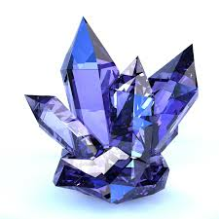
Introduction to Crystal
Introduction of crystallography
History and content
Concept of crystal
Non-crystal and quasi-crystal
Space lattice
The basic properties of crystals
A regular geometric solid bounded by smooth surfaces
Notes:
Usually when we talk about crystals, there will be a quartz-like solid in our brains, transparent, hard. However this is just quite superficial impression and understanding. What is crystal, why do we study crystal, what is crystallography, what are the intrinsic properties of crystals? That's what we're going to discuss.

Slide 11
“世界是物质的，物质是运动的，运动是有规律的，规律是可以认识的，认识是发展变化的 ” ——卡尔·马克思（Karl Heinrich Marx）
材料是人类赖以生存和发展的物质基础，有用的物质都可以称之为材料（主观的定义）。—— 百度
→ 人类社会是材料的
Notes:
“哲学是关于世界观和方法论的理论体系。世界观是关于世界的本质、发展的根本规律、人的思维与存在的根本关系的认识，方法论是人类认识世界的根本方法。方法论是世界观的功能，世界观决定方法论。”

Slide 12
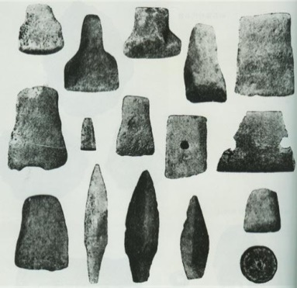
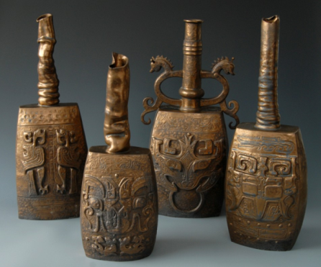
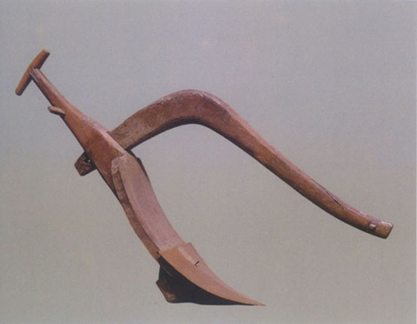
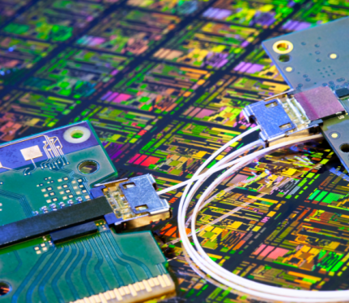
Material is a broad term for a chemical substance or mixture of substances that constitute a thing.
The Stone Age
the Bronze Age
the Iron Age
the Information Age
Material is the substance foundation for human survival and development.
Most materials exist as solids; Most solids are crystals and crystals are one form of materials (why?).
Notes:
Human history has gone through four eras！From the stone age, bronze ware, iron age to the present silicon information age, every great social progress depended on the discovery and application of new materials.
In the Stone Age, humans used stones directly as tools;In the Bronze Age, due to the mature use of fire by human beings, alloy metal bronze with relatively low melting point could be smelted as materials for various tools and weapons.In the iron age, humans mastered the method of producing higher temperatures, and were able to smelting high temperature and high hardness metal iron, which was widely used in agricultural tools and weapons. This led to the rapid development of agriculture, the increase of population and the integration of countries. Now, we are in the information age, and the key material that underpins this age is silicon, which is used in a wide variety of applications.
Solids are low energy stable states, where crystals have the lowest energy and are the most stable, so matter tends to exist as crystals.
Bronze is an alloy of lead and tin for copper.

Slide 13
Introduction
Crystallography: a subject based on crystal.
It mainly studies the symmetry of crystals, including the common law of crystals, but not the specific crystals.
Features: spatiality（空间性）, abstractness, logic and generality
Significantly different with mineralogy
Mineralogy: a subject about mineral crystal. It mainly study the compositions, physical properties and growth characteristics of specific mineral crystals.
Features: experience, sensibility, concreteness （具体性）, classification and individuality
Notes:
Mineralogy 英 [ˌmɪnəˈrælədʒi]
plane geometry and solid geometry (平面和立体几何）

Slide 14
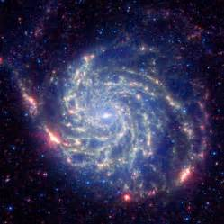
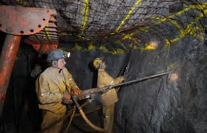
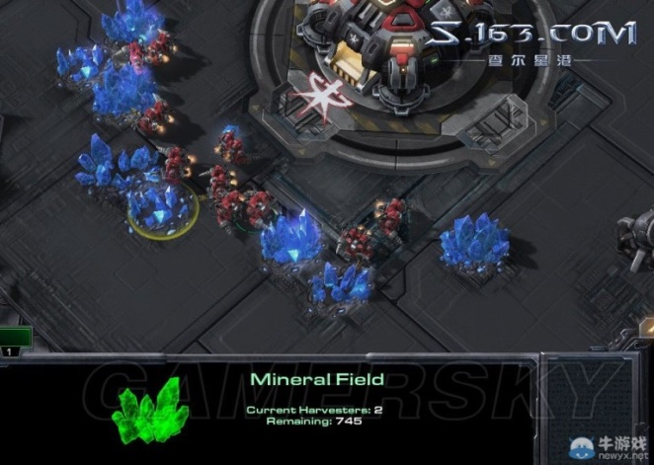

History of crystallography
Crystallography originates from human mining activities in the middle of the 17th Century.
It is one of the two earliest sciences in human history (astronomy is the other one).
Notes:
In ancient times, humans had no ability to process raw materials.
Minerals & mining

Slide 15
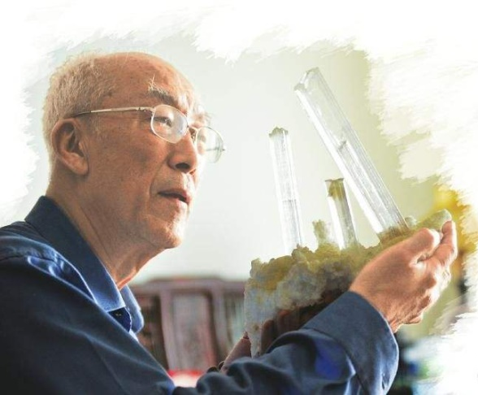
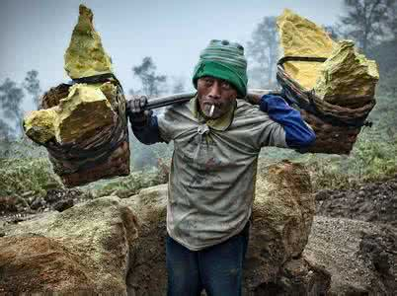
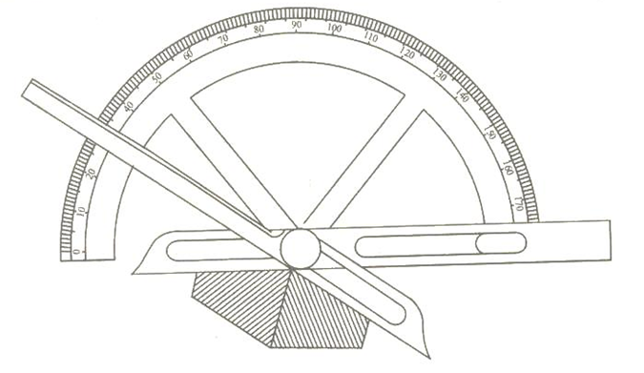
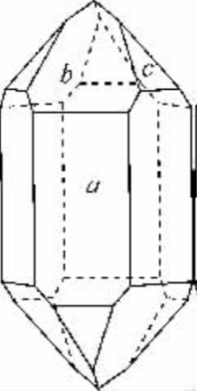
History of crystallography
The 17~18th century: Study of crystal morphology and the preliminarily study on geometric laws of the internal structure of crystals began.
Notes:
X射线的波长范围：0.001～100 纳米
买个硅的单晶实物

Slide 16
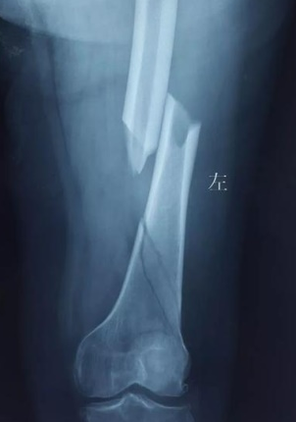
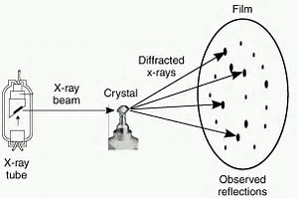
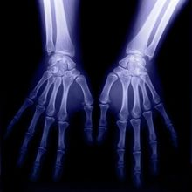
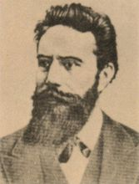
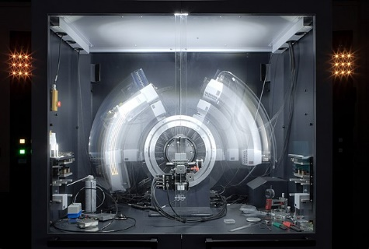
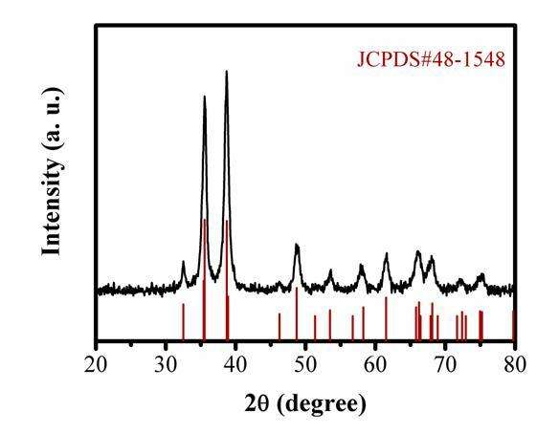
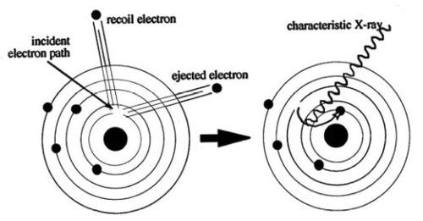
History of crystallography
Mini Project：光的单缝衍射和多缝干涉？
At the end of 19 century to early 20th century: the finding of X-ray and its applications on crystal structure measurement lead to the research into the internal structure of crystals;
特征X射线？
Roentgen
(德)伦琴
λ 0.001～100 nm
Notes:
X射线的波长范围：0.001～100 纳米
买个硅的单晶实物
The ray incident into the crystal structure, because of the periodic arrangement of the crystal atoms, the crystal can be regarded as a grating to scatter the ray, thus we get the information of the crystal structure.
In the XRD photo, we can obtain the diffraction pattern of the crystal structure, which can give the periodic information of the crystal structure. Diffraction is the same thing as taking the Fourier transform, giving you the frequency information.
光的干涉现象 ：它是指因两束光相遇而引起光的强度重新分布的现象。条件：两束光波相遇产生干涉现象的必要条件是：①频率相同；②光矢量(即电场强度矢量E)的振动方向相同；③在相遇处两束光的相位差恒定。
光在传播过程中，遇到障碍物或小孔（窄缝）时，它有离开直线路径绕到障碍物阴影里去的现象。这种现象叫光的衍射。
衍射时产生的明暗条纹或光环，叫衍射图样。
产生衍射的必要条件：光波与小孔或者物体尺度可以相比。。。

Slide 17
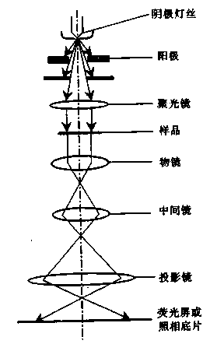
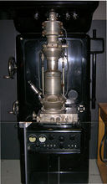
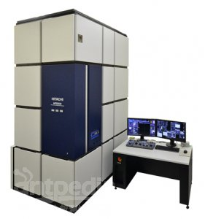
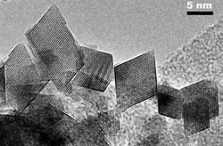
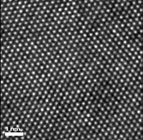
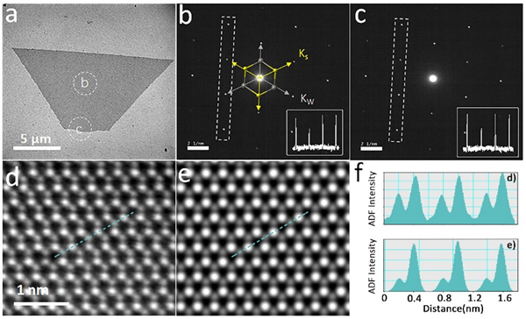
History of crystallography
Mini Project：透射显微镜的发展历史和基本原理？
Since 1970s, the ultrastructures of crystals have been studied by transmission electron microscopy;
Cs Correct
TEM
1928
加速的电子-物质波，又称德布罗意波
λ=h/p
Notes:
微观粒子的波动性发现（物质波，又称德布罗意波）
The first practical TEM, originally installed at IG Farben-Werke and now on display at the Deutsches Museum in Munich, Germany.
The electron beam has a smaller wavelength, and through two Fourier transforms, the electron interacts with the crystal, showing the structure inside the crystal directly.

Slide 18
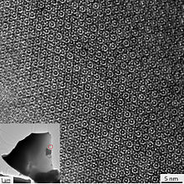
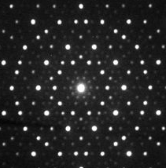
History of crystallography
In 1980s, the discovery of quasicrystals has opened up a new field of crystal symmetry theory，awarded Nobel Prize on Chemistry, 2011.
Atomic image of a micron-sized grain of the natural Al71Ni24Fe5 quasicrystal (shown in the inset) from a Khatyrka meteorite. The corresponding diffraction patterns reveal a ten-fold symmetry

Slide 19
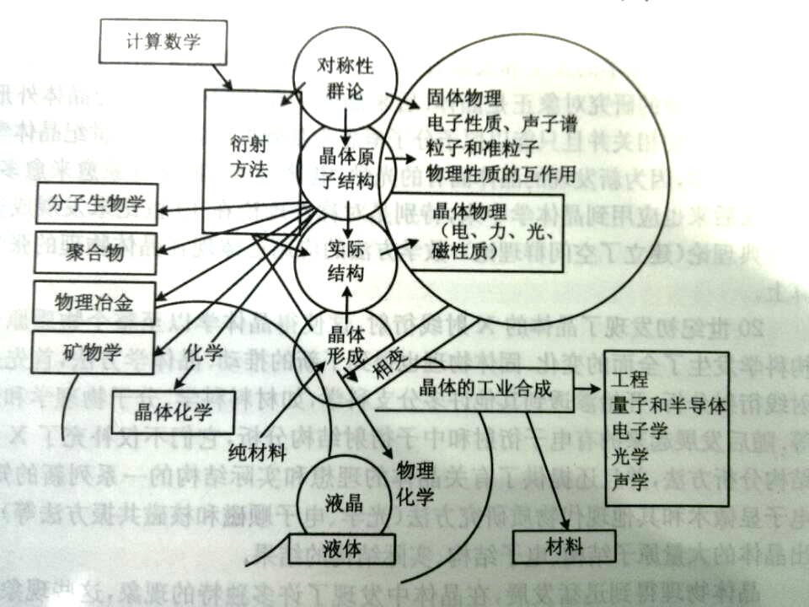
The relationships with other subjects
Notes:
对称性，群论，晶体原子结构，实际结构，晶体形成，液晶，液体，计算数学，衍射方法，分子生物学，聚合物，物理冶金，矿物学，化学，晶体化学，固体物理，电子性质、声子谱，粒子和准粒子，物理性质的相互作用，晶体物理（电，力，光，磁性质），晶体的工业合成，工程，量子和半导体，电子学，光学，声学，材料，物理化学

Slide 20
The relationships with other subjects
Computational mathematics
Symmetry, group theory,
Solid state physics, electronic properties, phonon spectrum, particles and particles,
The interaction of physical properties
Diffraction method
Crystal atomic structure
Molecular biology
Polymer
Physical metallurgy mineralogy
Crystal physics (electrical, mechanical, optical and magnetic properties
Actual structure
Chemistry
Phase transition
Engineering, quantum and semiconductor, electronics, optics, acoustics
Industrial synthesis of crystal,
Crystal chemistry
Crystal formation
Pure materials
LCD
Physics and chemistry
Liquid
Material
Notes:
对称性，群论，晶体原子结构，实际结构，晶体形成，液晶，液体，计算数学，衍射方法，分子生物学，聚合物，物理冶金，矿物学，化学，晶体化学，固体物理，电子性质、声子谱，粒子和准粒子，物理性质的相互作用，晶体物理（电，力，光，磁性质），晶体的工业合成，工程，量子和半导体，电子学，光学，声学，材料，物理化学
The atomic structure of a crystal is an abstraction of the actual structure.

Slide 21

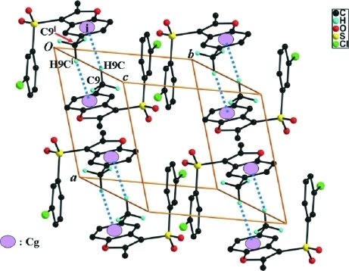
content of crystallography
Crystallography has several branch subjects such as crystallogeny (晶体生成学), geometrical crystallography, crystal structure, crystal chemistry, crystal physics.
This course mainly focuses on crystal morphology, symmetry laws of crystal structure. Crystal growth will also be introduced.
Notes:
晶体发生学（crystallogeny）又称晶体生成学。结晶学的一个分支。研究晶体的发生、成长、变化等方面的现象、机理和规律。

Slide 22
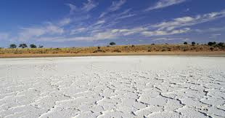
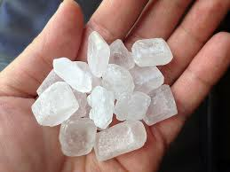
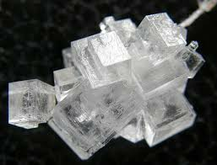
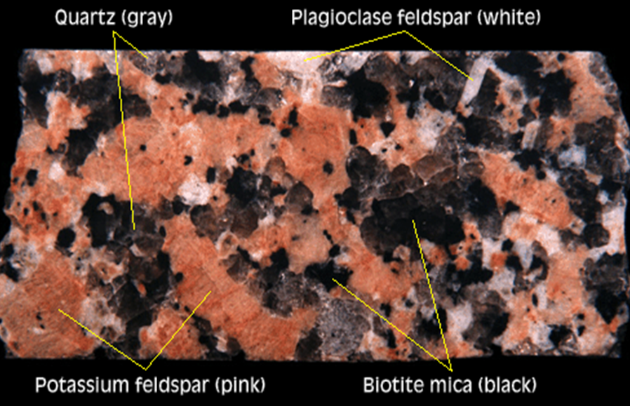
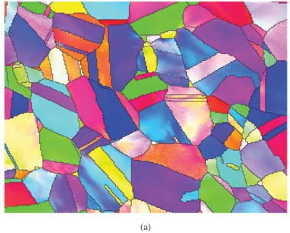

Crystals in Nature and Life
Rock Candy
斜长石
斜长石
EBSD of stainless steel
Notes:
plagloclase feldspar [ˈpleidʒiəukleis ˈfeldspɑ:] 斜长石，是一种在地球上很常见且很重要的硅酸盐矿物。
http://www.scielo.br/scielo.php?pid=S1516-14392007000400007&script=sci_arttext
（不锈钢多晶取向EBSD分布图）
云母
云母（mica或glimmer[1] )是分布最广的造岩矿物，钾、铝、镁、铁、锂等层状结构铝硅酸盐的总称

Slide 23
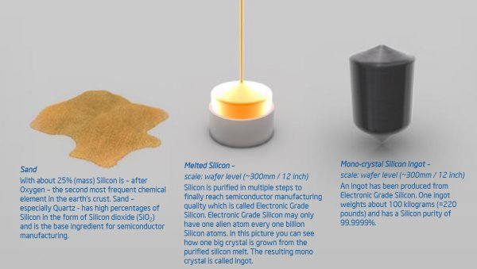
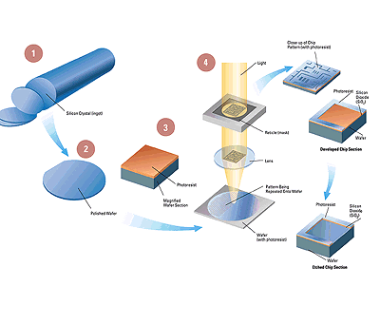
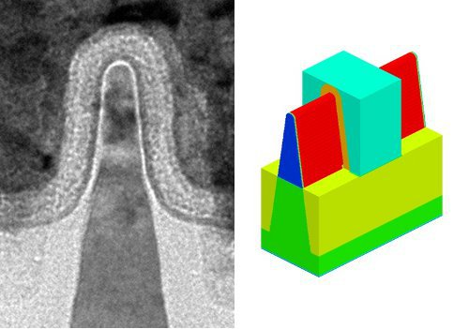
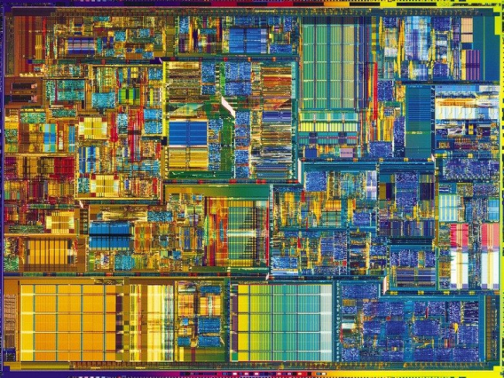
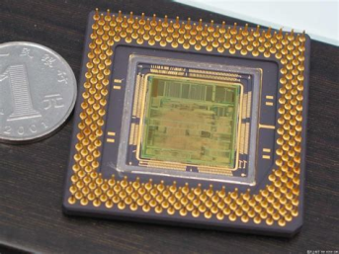
Crystals in Nature and Life
Silicon Ingot
Wafer
FinFET
Chip
Inside
Notes:
household appliances 家用电器
Sand
鳍式场效应晶体管 FinFET

Slide 24
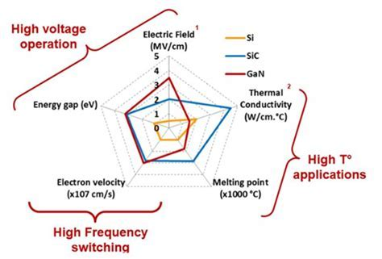

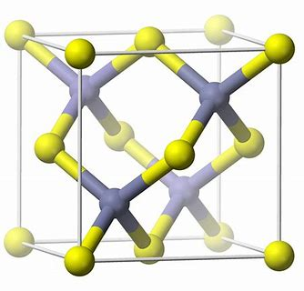
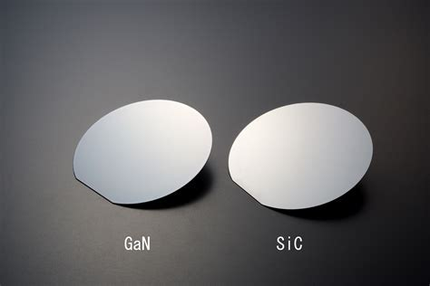
Crystals in Nature and Life
1st Si & Ge
(ICs)
2nd GaAs (Optoelectronic system)
3rd SiC & GaN
(Power Devices)
Notes:
雷达图
第一代半导体材料以锗和硅为代表，被广泛运用于集成电路制造领域，比如现在大家电脑和手机中的CPU和GPU就是采用硅材料制造的，美国硅谷也因“硅”而得名。
第二代半导体材料以砷化镓、磷化铟为代表，主要应用于以光发射器件为基础的光显示、光通信和光存储等光电子系统，比如高通最近就打算让自家的射频芯片采用砷化镓材料。
第三代半导体材料则以氮化镓、金刚石、碳化硅等为代表，氮化镓化学性质非常稳定，具有有宽的带隙、强的原子键、高的热导率、耐腐蚀等优点，熔点高达1700摄氏度，击穿电压高，抗辐射能力强。
诚然，在军工等对成本不敏感的领域，第三代半导体材料已经被运用，比如国产新锐战机上就搭载了采用氮化镓元器件的雷达。但在民用市场，第三代半导体材料市场前景有限。一方面是因为成本问题，用第三代半导体材料过于昂贵，另一方面，基于第三代半导体材料的特性，在功率器件等方面优势明显，在光电子和高频微波器件等方面具有应用潜力，但在逻辑器件上相对于硅而言是没有任何性价比的。在硅材料成本低廉且产业链成熟的情况下，商家没有动力去使用新材料。事实上，即便是民用器件，一些商家也都在玩“材料降级”，比如一些公司就把原本采用第二代半导体材料砷化镓的射频芯片换成SOI工艺以降低成本。

Slide 25
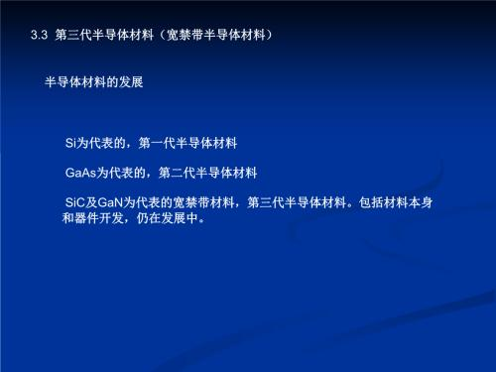

Slide 26

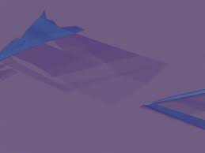
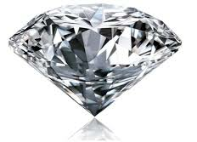
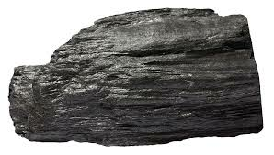
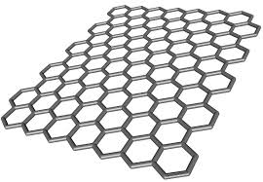
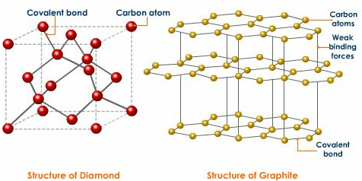

Crystals in Nature and Life
Notes:
硅的电子迁移率为l400cm2／(V.s)，电子在石墨烯中的传输速度是在硅中的100倍，因而未来的半导体材料是石墨烯而不是硅。
Allotrope 同素异形体

Slide 27



















Crystals in research
ZnO family

Slide 28

Crystallography and materials Science
HRTEM
XRD
SAED
(FFT)
CBED
Notes:
看文章碰到的问题 1，英语？2，专业词汇？3，相关的技术的原理和分析？

Slide 29
Crystal(concept)
Crystal(晶体)：homogeneous solid containing long-range order in three dimensional space. A crystalline solid or a crystal is one in which groups of atoms or ions are bonded to each other in a regular manner to form a periodic array（translational symmetry）.
The long-range order of the regular array, or periodicity, is the most important property of crystals.
The regular array of atoms in a crystal is manifested by the flat faces of the characteristic polyhedral shape of the crystal.
However, crystals are often too small to be seen without a microscope.
Many of the materials we are familiar with are composed of a collection of many small crystals. Such materials are termed polycrystalline.
Notes:
从晶体学发展的历史和自然界中存在的晶体，归纳出晶体的本质概念
Solid materials are usually classified into crystalline and amorphous (non-crystalline) materials according to whether the atoms or ions in the solid are arranged regularly or not.

Slide 30





Crystal(concept)
long-range order
hydrogen peroxide(H₂O)
short-range order
Notes:
晶体内部的质点排列具有周期性(长程有序, long-range order)； 在原子近邻具有的周期性，叫短程有序(short-range order)， 液体具有短程有序，无长程有序；气体既无长程，也无短程有序
Short range order refers to the regular and predictable arrangement of atoms over a short distance
在非晶态结构中，原子排列没有规律周期性，原子排列从总体上是无规则的，但是，近邻的原子排列是有一定的规律的这就是“短程有序”。
Long- and short-range order
A solid is crystalline if it has long-range order. Once the positions of an atom and its neighbours are known at one point, the place of each atom is known precisely throughout the crystal. Most liquids lack long-range order, although many have short-range order. Short range is defined as the first- or second-nearest neighbours of an atom. In many liquids the first-neighbour atoms are arranged in the same structure as in the corresponding solid phase. At distances that are many atoms away, however, the positions of the atoms become uncorrelated. These fluids, such as water, have short-range order but lack long-range order. Certain liquids may have short-range order in one direction and long-range order in another direction; these special substances are called liquidcrystals. Solid crystals have both short-range order and long-range order.
https://www.britannica.com/science/crystal#ref506252

Slide 31
Non-crystal and quasicrystal
Non-crystal (非晶体): Solids that internal mass particles are not periodically repeated in three-dimensional space. (glass, rosin, amber, etc). They possess of short-range order but do not have long-range order.
Internal structure of α-silica
Internal structure of SiO₂ glass

Slide 32
Non-crystal and quasicrystal
Quasicrystal（准晶体）：A quasiperiodic crystal, or quasicrystal, is a structure that is ordered but not periodic. A quasicrystalline pattern can continuously fill all available space, but it lacks translational symmetry.
According to the crystallographic restriction theorem，crystals only have two, three, four or six fold rotational symmetries, but quasicrystals have other rotational symmetries, such as five fold symmetry or higher as more than six fold symmetry.
Notes:
晶体中既存在短程有序又存在长程有序。
但在非晶质体如玻璃体中，质点虽然可以是近程有序的，但不存在长程有序。
在气体中则既不存在长程有序，也不存在近程有序。
准晶体质点的排列应是长程有序，但不体现周期重复，即不存在格子构造。

Slide 33
Five fold symmetry without translational symmetry

Slide 34

More examples
Mini Project：莱纳斯·鲍林的生平和科研简介？
准晶:被双料诺奖得主鲍林斥为nonsense的伟大发现
http://www.360doc.com/content/10/1123/11/2291725_71665279.shtml
Notes:
莱纳斯·鲍林:诺贝尔化学奖和平奖双料得主

Slide 35
Non-crystal and quasi-crystal
At present, there are 28 kinds of quasi crystalline point groups, including 5 crystal systems.
crystal system | symmetry element
pentagonal | Only one 5 fold axis
octagonal | Only one 8 fold axis
decagonal | Only one 10 fold axis
dodecagonal | Only one 12 fold axis
icosahedral | Ten 3 fold axis
2011 Nobel Prize in Chemistry went to Quasi-crystals
Notes:
http://www.nobelprize.org/nobel_prizes/chemistry/laureates/2011/advanced-chemistryprize2011.pdf
http://science.sciencemag.org/content/sci/315/5815/1106.full.pdf
(参考文章)

Slide 36



Figures: Electron diffraction, 8-fold symmetry and 2D quasiperiod structure and HRTEM image of the octagonal quasicrystal.
See details... “Two-dimensional quasicrystal with eightfold rotational symmetry”, N. Wang, H. Chen & K. H. Kuo, Phys. Rev. Lett. 59 (1987) 1010.
This work has been cited in Scientific Background of the Nobel Prize in Chemistry 2011.
The discovery history of quasi-crystals can refer the following file:
https://wenku.baidu.com/view/d482dca6998fcc22bcd10de9.html

Slide 37





Mini Project：准晶最早的发现历史？
准晶的发现
Al₆Mn
Daniel Shechtman
1 μm
获得了具有五重对称,斑点明锐的电子衍射图.

Slide 38

Size-dependent hardness of five-fold twin structured Ag nanowires
Phys. Chem. Chem. Phys.,2017, 19, 1311

Slide 39


准晶不被认可
"I told everyone who was ready to listen that I had material with pentagonal symmetry. People just laughed at me," Shechtman said in a description of his work released by his university.
For months he tried to persuade his colleagues of his find, but they refused to accept it. Finally he was asked to leave his research group, and moved to another one within the institute.
1984年，投‘Journal of Applied Physics’
编辑的回信：“rejecting the article as not being of interest to physicists“

Slide 40




准晶的确认
法国CNRS冶金化学研究所
1984年秋，Gratias在加州大学的一次理论物理讨论会中听了Steinhardt的报告
Princeton University USA
Denis Gratias
Steinhardt, Paul J.
John W. Cahn
Mini Project：如何区别准晶和孪晶？

Slide 41



准晶的发表

Slide 42






Pauling and Shechtman 的论战
“ Danny Shechtman is talking nonsense. There is no such thing as quasicrystals, only quasi-scientists.”
1985年，Pauling的质疑文章发在Nature上。
1986年，Shechtman通过精确的观察否定了这些质疑，其反驳文章也发在Nature上。
1990年，Linus Pauling向Daniel伸去了橄榄枝，邀请他共同写篇文章 “Shechtman-Pauling,” on quasiperiodic crystals，Daniel回信，很高兴写这个东西，不过Linus要首先承认准晶是存在的；Linus回复，那这篇共同署名的文章时机还不成熟。

Slide 43



十二次对称性的发现
Surface Science Volume 156, Part 1, 3 June 1985, Pages 241-248
石政 勉
现：北海道大学
1985年Ishimasa等人报道了
Ni-Cr颗粒中的十二次对称性

Slide 44


Ti-基准晶合金
郭可信
中科院金属所，物理所 研究员
1984-1985年：Ti-V-Ni, Ti-Fe, Ti-Co
“五次对称性及Ti-Ni准晶相的发现与研究”
在1987年国家自然科学一等奖。
* Phil. Mag. A, 52 , 1985：L49
* Phil. Mag. A, 54 , 1986：L83
叶恒强
Ti基准晶的发现，创造了中国科学的一个奇迹，被认为是真正达到国际一流水平的研究，这项研究不仅培养了一大批青年科学家，还“培养”了四位中国科学院院士，他们是叶恒强、李方华、张殿林和张泽院士。

Slide 45



一、二维准晶合金
1988年5月至1990年12月张院士以客座科学家身份在德国核研究中心固体物理所工作，其间他在铝铜钴合金的二维准晶研究中发现一维准晶，在Al-Cu-Fe合金的三维准晶相变研究中发现二维准晶。特别是，他在世界上首次发现了铝铜钻十次对称准晶中的位错及层错；首次用常规衍射衬度方法系统地研究了五次对称准晶的位错；在世界上首次发现十次对称准晶中的“位错”等缺陷，并在国际上率先开展了系统的观察和研究。提出准晶中位错研究的新理论。两篇关于准晶中缺陷研究的代表性论文在发表后三年内被引用110余次，并被国际学术会议特邀报告人在报告中多次引用。
张泽

Slide 46



稳定准晶的发现
1987年法国和日本的同行终于发现了足够大的准晶来做X射线衍射。
1987年Daniel带着X射线衍射的照片到了奥地利的一个晶体学大会，把准晶这事给铁板定钉了。
A Stable Quasicrystal in Al-Cu-Fe System
TSAI An-Pang，INOUE Akihisa，
MASUMOTO Tsuyoshi
Institute for Materials Research,
Graduate School, Tohoku University
Japanese journal of applied physics.
Pt. 2, Letters 26(9), L1505-L1507, 1987-09-20

Slide 47



稳定准晶的发现
2010.6北海道准晶会议
1, 稳定准晶的发现
2, 准晶形成
3, 准晶特性
日本东北大学金属材料研究所
日本金属材料技术研究所
日本东北大学多元研究所
发现由Cd-Yb两种元素构成的稳定准晶相，这些稳定准晶体具有极大的科学价值，他的这一科研成果发表在2000年11月30日出版的英国《自然》杂志上。

Slide 48






天然准晶
2009年，在俄罗斯一条河流内的矿物样品中发现了自然生成的Al63Cu24Fe13准晶体

Slide 49


Daniel Shechtman简历
个人经历
1941年出生于特拉维夫（英属巴勒斯坦托管地），以色列材料科学家，
以色列理工学院取得机械工程学士后，又接连取得材料科学硕士与博士学位。
美国能源部埃姆斯实验室(Ames Laboratory)助理、艾奥瓦州立大学材料科学教授。
美国工程院院士，欧洲科学院院士，以色列科学院院士
现任以色列理工学院杰出教授，
美国菲利普托比亚斯材料科学列席教授；
美国爱荷华州立大学杰出
日本东北大学杰出教授
河南理工大学兼职教授
北京工业大学兼职教授
获奖（10多项）
诺贝尔化学奖（准晶体的发现）（2011年） Wolf奖（物理）（1999年） 以色列奖（物理）（1998年
Weizmann科学奖
瑞典皇家科学院Aminoff奖

Slide 50


The difference between crystal, quasi-crystal and non-crystal (amorphous)
Short range
order
Long range
order
Translational symmetry
Rotational symmetry
Crystal
Quasi
Crystal
Non-
Crystal

Slide 51
Space Lattice( 空间点阵）
Basic Terms (基本术语)
mass point（质点）, such as atom、ion or molecule
node (结点) or lattice point (阵点)
row (行列) and row-spacing (结点间距)
net (面网), reticular density (面网密度) and plane spacing (面网间距)
space lattice or lattice (空间点阵或格子)
unit cell (单位晶胞)

Slide 52
Structure → lattice
Notes:
cesium chloride CsCl

Slide 53

Structure → lattice
Find equivalent points (EP) firstly
Connect these EPs to form lattice
EPs(相当点): points have the same properties and environment
Simple Cubic
Notes:
Extract the lattice firstly

Slide 54

Extract symmetry of crystal structures
1. Set one point as original point
+
Structure
2. Find EPs of the original point
Equivalent points
3. The EPs form the lattice of the studied pattern/ structure
Lattice
Notes:
晶体和其他固体的区别在于它的周期性重复规律（平移不变性）；
如何把这种周期性重复规律找出来，是我们研究晶体结构的基础。
内部结构看起来很不一样的晶体，其周期重复规律可以是一样。
这里我们要做的事情就是把晶体抽象成空间点阵，它是表示晶体结构周期重复规律的简单几何图形。

Slide 55

Relationship between crystal structure and lattice
A crystal structure can be regarded to be constructed by several sets of space lattices with the same periods.
It is hard to directly find the period of detailed crystal structures, which always consist of several kinds of atoms and ions.
Space lattice can make the period of crystal structures more prominent.
Space lattice is only a geometric representation of periodic repetition in a crystal structure. It is much simpler than a specific crystal structure.

Slide 56
Structure → lattice
one dimensional （1D）
A－NaCl structure in y axis
B－The linear array of Na+ （same as Cl⁻）
C－abstracted as a linear dot chain (lattice)
Where is EPs？
Notes:
You abstract each ion into a point and you get a lattice

Slide 57
EP？
EP？
Notes:
No matter where you start, you end up with the same lattice, right？

Slide 58
EP？
EP？
EP？

Slide 59

Exercise 1

Slide 60



Exercise 2
1-dimensional chain of [Cu(L)Cl]
catena-Poly[[[diaqua-bis(2-methyl-6-oxo-1,6-dihydro-3,4'-bipyridine-5-carbo-nitrile)copper(II)]-μ-sulfato] tetra-hydrate].
Notes:
http://www.chemie.unibas.ch/~fromm/WEBfromm/res.html

Slide 61
Structure → lattice
2D structure
(a)－NaCl structure in xy plane
(b)－Na⁺ or Cl⁻ array
below－ abstracted as plane dot arrays

Slide 62
Structure → lattice

Slide 63

Exercise 3
Determine the lattice of the 2D structure (graphene).

Slide 64




Exercise 4

Slide 65
Exercise 4

Slide 66





Exercise 5
Notes:
窗帘布料贴图 为关键字百度搜索图片

Slide 67
Structure → lattice
3D pattern
Left－NaCl structure in 3D space
Right －abstracted as space lattice
Notes:
把每一层的点阵画出来，然后层叠就形成晶体的三维点阵？

Slide 68


Exercise 6
determine the space lattice of graphite structure.
Projection ？
Notes:
determine the space lattice of the projections of the right 3D pattern.

Slide 69

Structure → lattice
Structure = Motif × Lattice
Point group
（rotational symmetry）
Translational group
（translational symmetry）
Space group
=
×
Notes:
单层石墨烯和石墨晶体的二维点阵（Z向投影）有什么区别？
纵向上也要注意对等点的概念，石墨晶体的对等点要隔一层才可以。

Slide 70
Node (结点) or Lattice point(阵点): each point in space lattice, equals to the EPs in crystal structures. Row (行列): the arrangement of lattice points in certain direction with the same distance
Elements of lattice

Slide 71
Elements of lattice
Net (面网): the distribution of lattice points in plane.

Slide 72

Elements of lattice
Net distance
Net density
Net density decreases with net distance. Therefore these two elements are in proportional.
Net AA’ distance d₁
Net BB’ distance d₂
Net CC’ distance d₃
Net DD’ distance d₄

Slide 73
Elements of lattice
Unit cell（晶胞）: the smallest unit formed by lattice points in 3D space after considering symmetry.
Cell parameters/lattice parameters（晶胞参数）:
a, b, c; α,β,γ ,also called axial lengths and axial angles
α
β
c
γ
a
b

Slide 74
Elements of lattice
Unit cells are always parallelepiped（平行六面体） in different shapes, which have various lattice parameters.
There are only seven kinds of parallelepipeds, which correspond to 7 sets of cell parameters and crystal systems

Slide 75
The basic laws of space lattice
The nodes/lattice points distributed in the same lines form a row. In a space lattice, there can be many rows in different directions. The parallel rows must have the same spacing; the unparallel rows are generally different in their spacing；
The nodes that are connected together in the same plane form a net. In a space lattice, there can be infinite nets in different directions, but the spacing and the density of the parallel planes must be equal;
The nodes connected in the three-dimensional space form a space lattice. The space lattice can divided as a series of parallel parallelepipeds by three sets of parallel rows with the nodes are distributed on the top of their corners.
The size and shape of a parallelepiped can be expressed by node spacings of a, b, c and their intersection α、β、γ. They are called lattice parameters or cell parameters.

Slide 76


Reciprocal lattice
With the development of crystallography, P.P., Ewald introduced the concept of reciprocal lattice in 1920 in order to explain crystal diffraction phenomenon and some problems in crystal physics.
Paul Peter Ewald
(1888-1985)

Slide 77
Reciprocal lattice
The reciprocal lattice: a kind of spatial geometry established on the basis of crystal lattice. It is another form of crystal lattice, directly showing the periodicity of lattice.
It is called inverted lattice because of the existence of reciprocity relationship between many of its properties and those of the crystal lattice.
The use of reciprocal lattices to deal with geometric relations and diffraction problems of crystals can make geometric concepts clearer and mathematical deduction easier.
Diffraction patterns that we observe is actually meet the conditions of the diffraction projection of the reciprocal lattice points. It is thus clear that diffraction patterns are the images of crystal structures in reciprocal spaces. So, in this sense, the reciprocal lattice itself has diffraction properties.

Slide 78


Reciprocal lattice
Notes:
这部分暂时没法讲，很多的概念如密勒指数都没有学，放在后面。

Slide 79

Reciprocal lattice

Slide 80

Reciprocal lattice

Slide 81


Reciprocal lattice

Slide 82


Reciprocal lattice

Slide 83
Basic properties of crystals
Homogeneity: The chemical compositions and physical properties of any two parts of a crystal are equivalent. The mathematical formula can be used to represent the small crystals obtained at x and X + X’ in a crystal.
F(x) ≡ F (x + x’)
Here, F represents physical measures such as chemical compositions and properties; X and X’ are lattice vectors.
Anisotropy: The physical properties of crystals are related to their directionality. If taken two arbitrary directions, n₁and n₂,
F(n₁) ≠ F(n₂)
That is, the physical properties of crystals vary in different directions.
Notes:
石墨层内原子sp2杂化键，层间大Pi键，导热，导电均不一样

Slide 84
Basic properties of crystals
Symmetry: if the directions of n_{1，}n_{2，}and even n_{n} can be coincident by symmetric operations, there is
F(n₁) = F(n₂) = ⋅⋅⋅= F(n_{n})
That is to say the crystal properties of F is symmetrically configured about n_{1，}n_{2，}and even n_{n}.
Self – norm (self - limiting) anisotropy: the appearance of crystalline physical can spontaneously forms a closed convex geometry (凸面几何体）, and satisfies the laws of Euler
F + V = E + 2
F: number of crystal facets; E: number of crystal edges; V: number of vertexes
Minimum internal energy: in the same thermodynamic conditions, the internal energy of crystals is the smallest compared to those of gases, liquids, and amorphous compounds with the same chemical compositions.
Stability: in the same thermodynamic conditions, the crystals are stable compared to those with the same chemical compositions.

Slide 85
Key summary
The most important concepts of this chapter:
crystal, non-crystal, quasi-crystal; crystal structure, lattice construction, space lattice, equivalent point;
node/lattice point, row, net, parallelepiped; node distance, net distance and net density;
basic properties of crystals: homogeneity, anisotropy, symmetry: self – norm (self - limiting) anisotropy, minimum internal energy, stability.

Slide 86
homework
Provide the crystal lattices of the two structures below
Exercise 1-6 in the PPT

Slide 87



